Slide 1

Unlocking Customer Insights
A comprehensive analysis of customer shopping behavior to drive strategic decision-making.

Slide 2
Project Overview & Objectives
This project analyzes 3,900 purchase records to identify customer spending patterns, evaluate trends, and segment customers.
Identify Patterns
Evaluate Trends
Generate Insights
Discover meaningful patterns in customer spending behavior.
Assess purchasing trends and the impact of discounts and subscriptions.
Provide actionable insights for customer retention, product positioning, and revenue optimization.

Slide 3

Dataset Summary
Our dataset comprises 3,900 rows and 18 columns, offering a rich view into customer demographics and purchase details.
Rows: 3,900
Columns: 18
Missing Data: 37 values in Review Rating
Key Features
Demographics
Customer demographics, purchase details, and shopping behavior.
Age, Gender, Location, Subscription Status.
Purchase Details
Behavior
Item, Category, Amount, Season, Size, Color.
Discount, Promo Code, Previous Purchases, Frequency, Review, Shipping.

Slide 4

Exploratory Data Analysis (Python)
Our Python-based EDA involved data loading, initial exploration, and crucial cleaning steps.
01
Data Loading & Exploration
Imported dataset, checked structure and summary statistics.
02
Missing Data Handling
Imputed missing 'Review Rating' values using median by product category.
03
Column Standardization
Renamed columns to snake case for improved readability.
04
Feature Engineering
Created 'age_group' and 'purchase_frequency_days' columns.
05
Database Integration
Loaded cleaned data into PostgreSQL for SQL analysis.

Slide 5

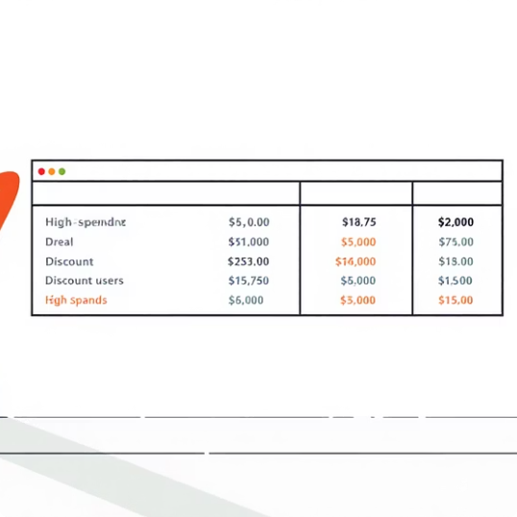
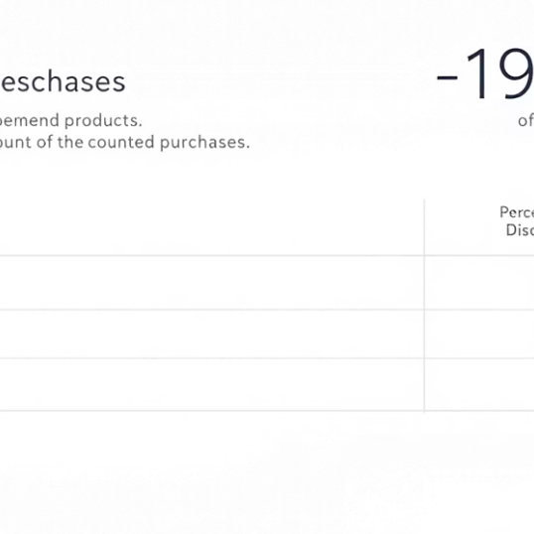
SQL Analysis: Revenue & Discounts
Structured SQL queries revealed key insights into revenue generation and discount utilization.
Revenue by Gender
High-Spending Discount Users
Discount-Dependent Products
Compared total revenue generated by male vs. female customers.
Found products with the highest percentage of discounted purchases.
Identified customers using discounts but spending above average.

Slide 6
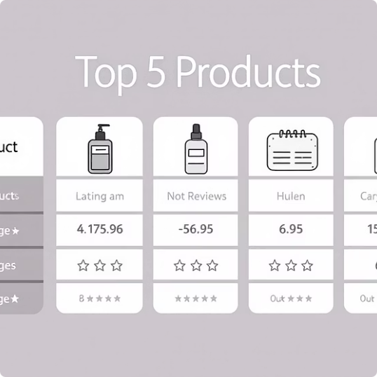
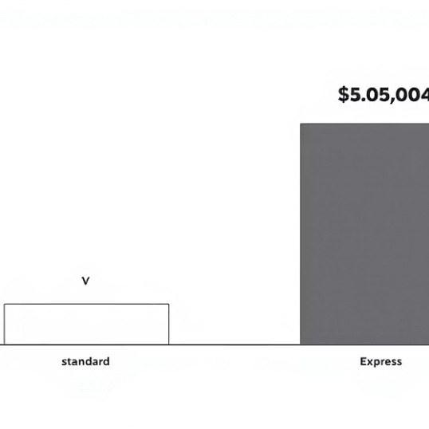
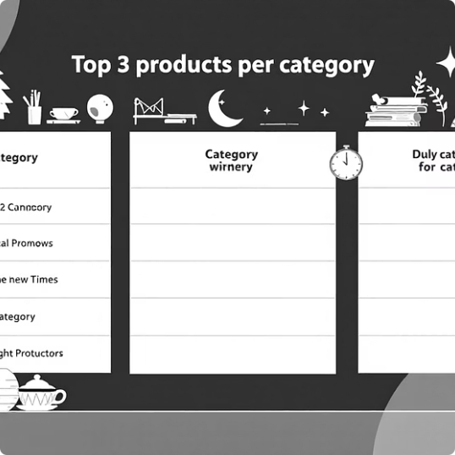
SQL Analysis: Product & Shipping
Deep dive into product performance and shipping preferences.
Top 5 Products by Rating
Shipping Type Comparison
Top 3 Products per Category
Identified products with the highest average review ratings.
Compared average purchase amounts between Standard and Express shipping.
Listed the most purchased products within each category.

Slide 7
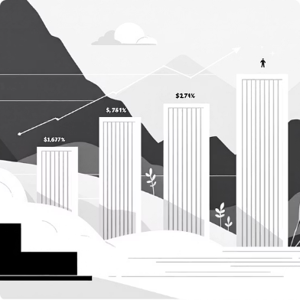
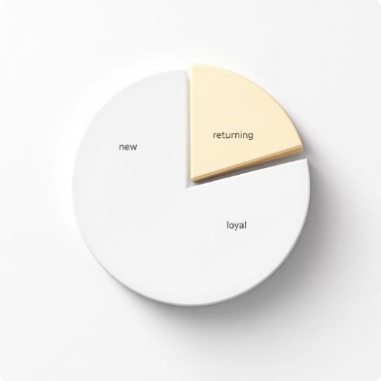
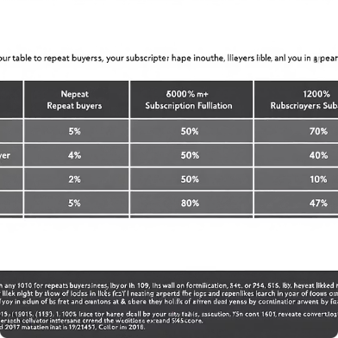
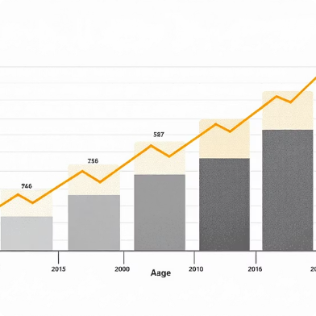
SQL Analysis: Customer Segmentation
Understanding customer segments and their relationship with subscriptions and purchase frequency.
Subscribers vs. Non-Subscribers
Customer Segmentation
Repeat Buyers & Subscriptions
Revenue by Age Group
Classified customers into New, Returning, and Loyal segments.
Calculated total revenue contribution of each age group.
Checked if customers with >5 purchases are more likely to subscribe.
Compared average spend and total revenue across subscription statuses.

Slide 8
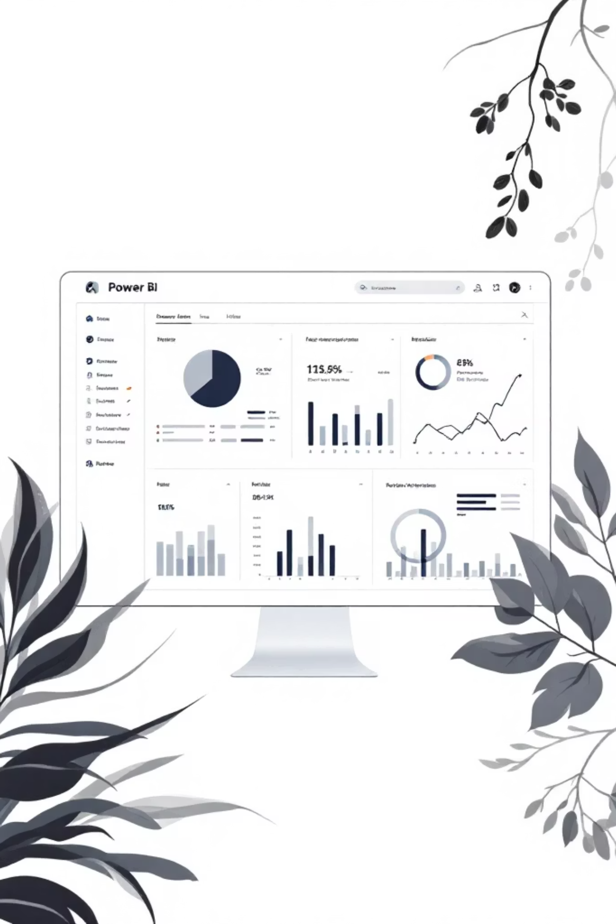
Interactive Power BI Dashboard
Visualizing key insights through an interactive dashboard for easy exploration.
The dashboard allows stakeholders to dynamically explore data, identify trends, and monitor performance metrics at a glance.

Slide 9
Actionable Business Recommendations
Leveraging data insights to formulate strategic recommendations for growth.
1
2
3
Boost Subscriptions
Customer Loyalty Programs
Review Discount Policy
Promote exclusive benefits to increase subscriber base and recurring revenue.
Optimize discount strategies to balance sales boosts with margin control.
Implement programs to reward repeat buyers and foster loyalty.
4
5
Product Positioning
Targeted Marketing
Highlight top-rated and best-selling products in marketing campaigns.
Focus efforts on high-revenue age groups and express-shipping users for maximum impact.

